Slide 1


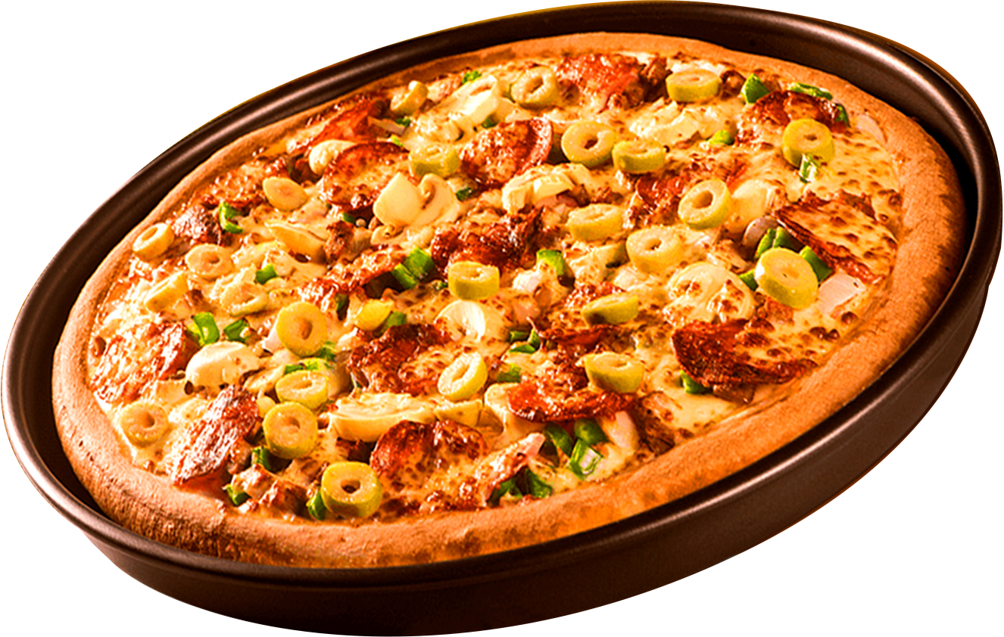
PIZZA SALES ANALYSIS

Slide 2

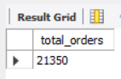
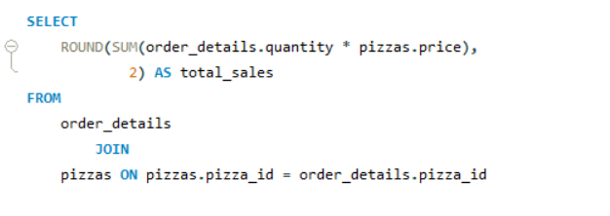
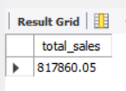
RETRIEVE THE TOTAL NUMBER OF ORDERS PLACED.
CALCULATE THE TOTAL REVENUE GENERATED FROM PIZZA SALES.

Slide 3
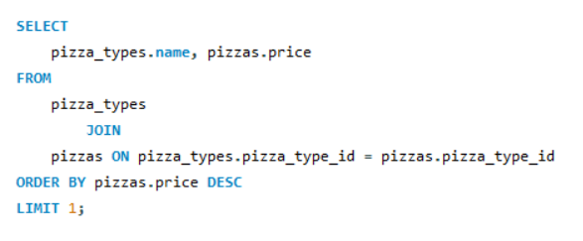
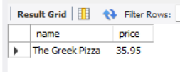
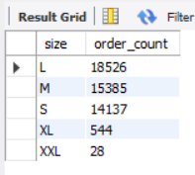
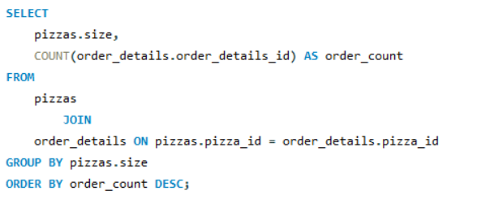
IDENTIFY THE HIGHEST-PRICED PIZZA.
IDENTIFY THE MOST COMMON PIZZA SIZE ORDERED.

Slide 4
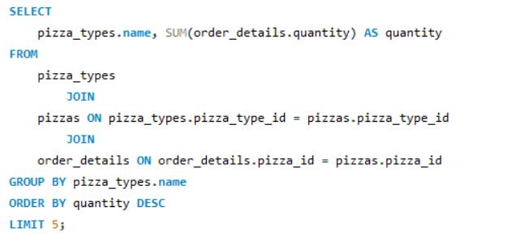
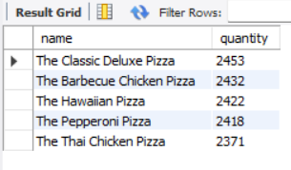
LIST THE TOP 5 MOST ORDERED PIZZA TYPES ALONG WITH THEIR QUANTITIES.

Slide 5
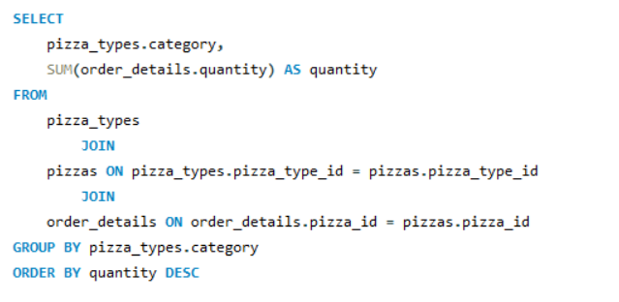
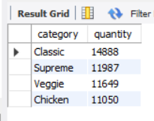
JOIN THE NECESSARY TABLES TO FIND THE TOTAL QUANTITY OF EACH PIZZA CATEGORY ORDERED.

Slide 6

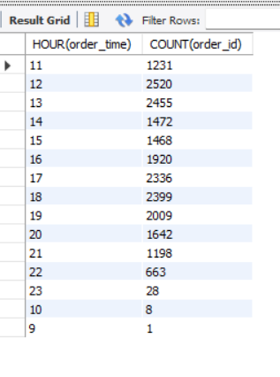
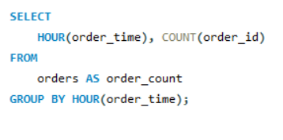
DETERMINE THE DISTRIBUTION OF ORDERS BY HOUR OF THE DAY.

Slide 7
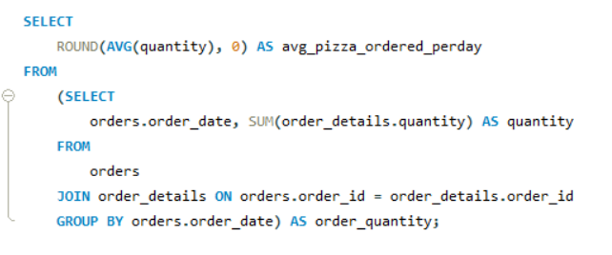
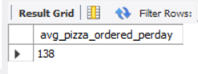
GROUP THE ORDERS BY DATE AND CALCULATE THE AVERAGE NUMBER OF PIZZAS ORDERED PER DAY.

Slide 8
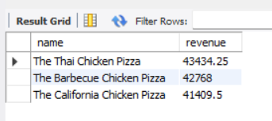
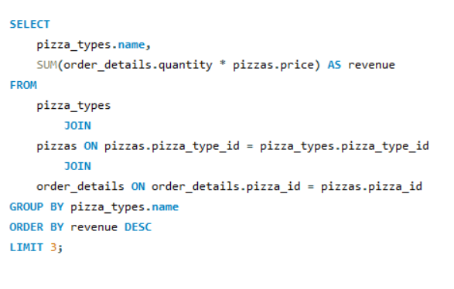

DETERMINE THE TOP 3 MOST ORDERED PIZZA TYPES BASED ON REVENUE.

Slide 9
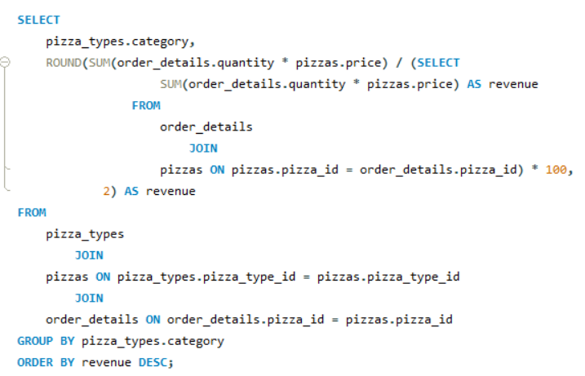
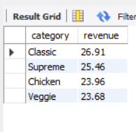
CALCULATE THE PERCENTAGE CONTRIBUTION OF EACH PIZZA TYPE TO TOTAL REVENUE.

Slide 10
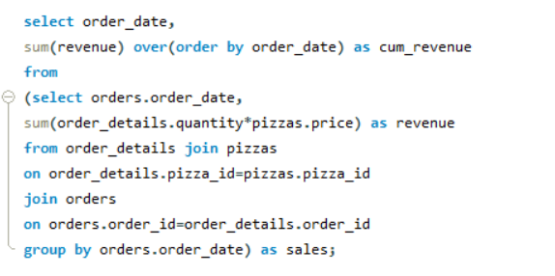
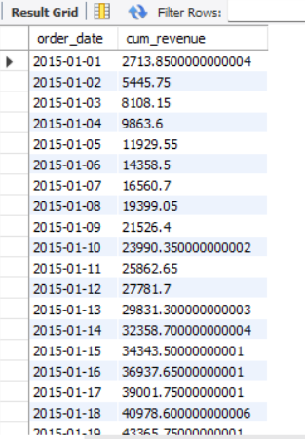
ANALYZE THE CUMULATIVE REVENUE GENERATED OVER TIME.

Slide 11
THANK YOU
FOR ATTENTION

